Slide 1
Wire-FU
Jason Ko
Ulysses Villagomez
Hwan Jung

Slide 2
Features
What are the best things about your game?
Physics engine
Cool graphics and sound
Polymorphism

Slide 3
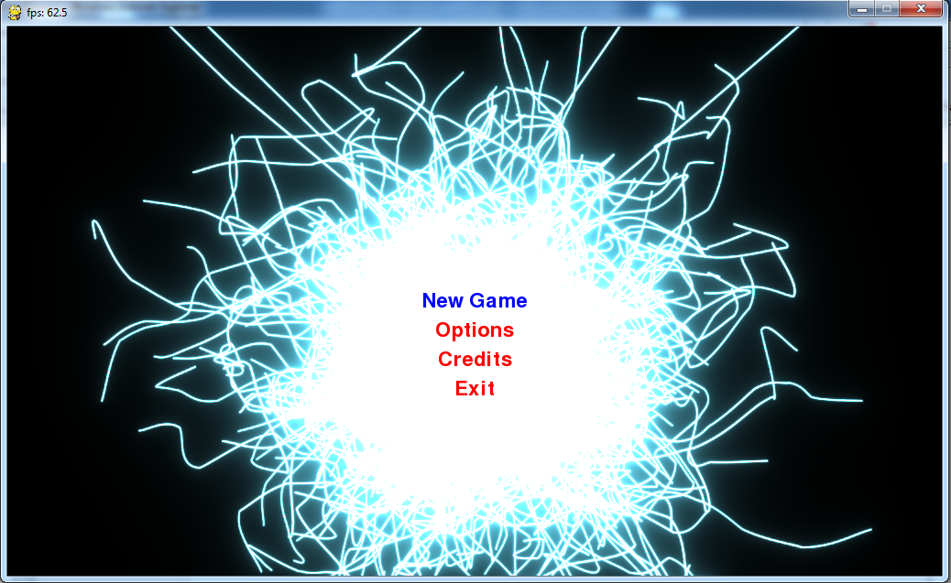

Slide 4
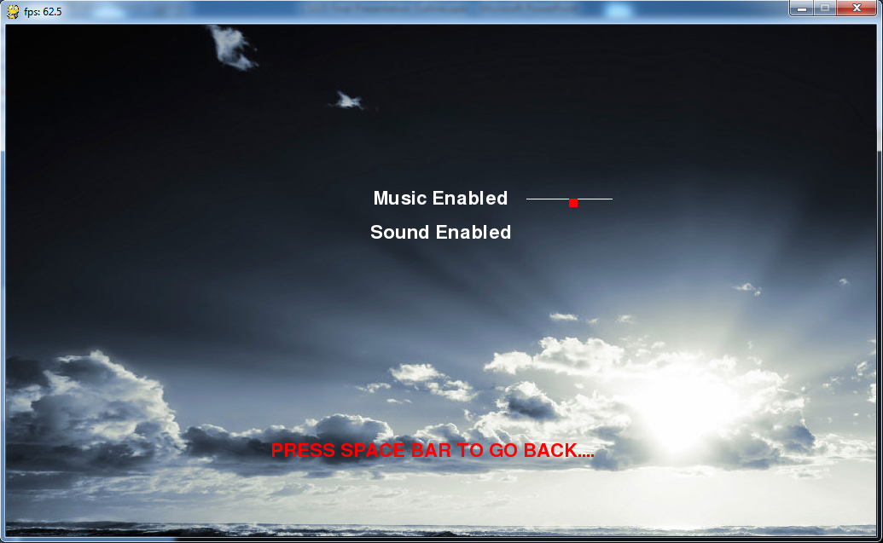

Slide 5
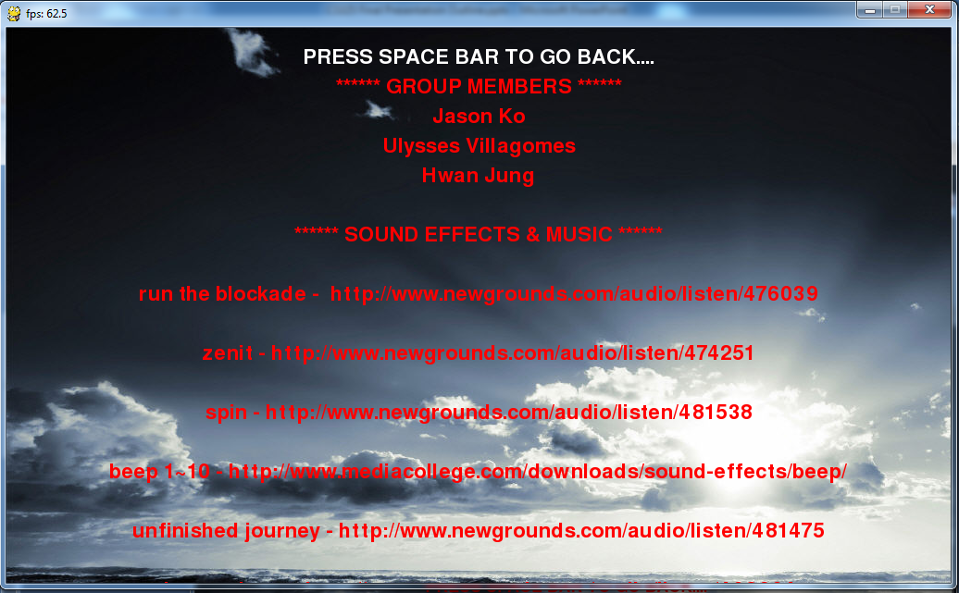

Slide 6
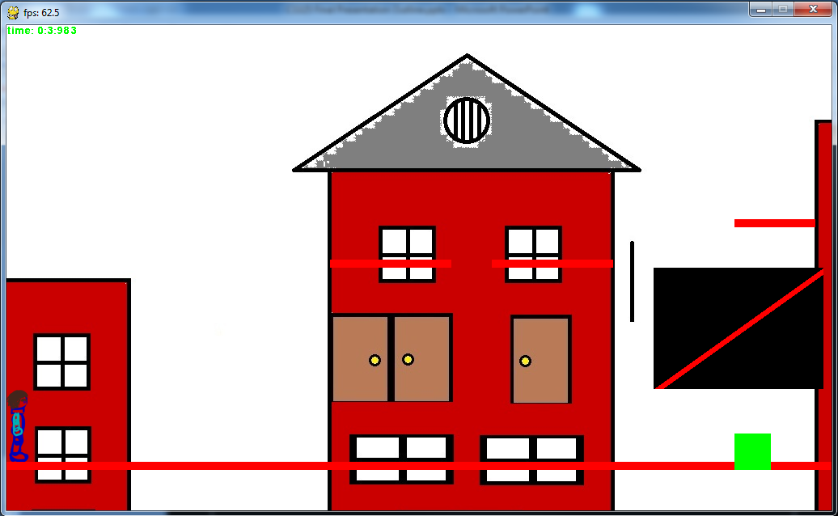

Slide 7
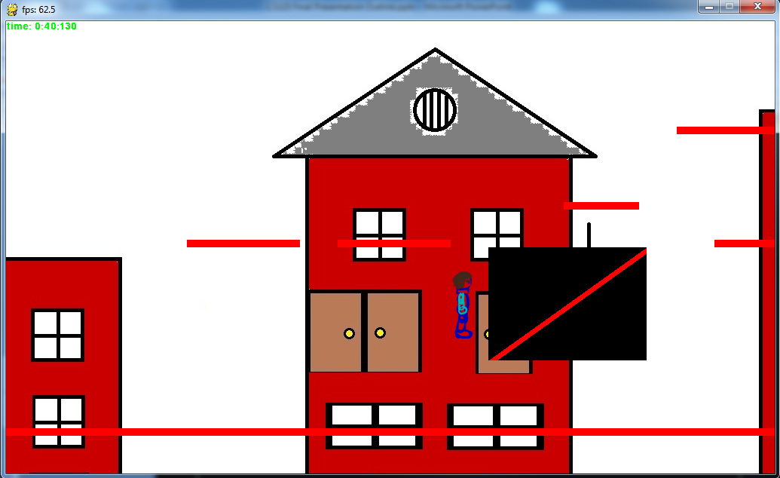

Slide 8
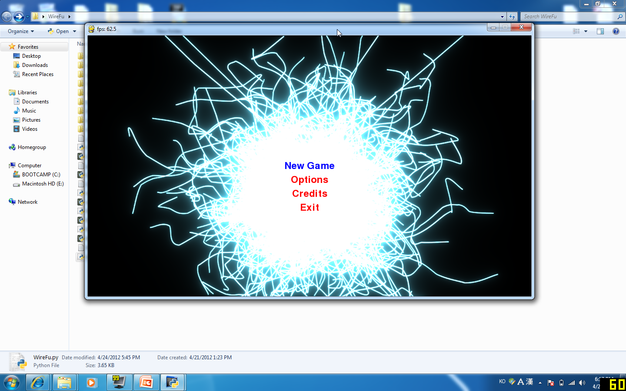
DEMO

Slide 10
Live Demo

Slide 11
Biggest Challenge
What is the biggest challenge that your team faced?
How did you overcome it?

Slide 12
Lessons Learned (for this, im just putting some things, so add your opinions)
What did you learn during development?
It’s hard to read someone else’s code and write code with their styles
It actually takes a long time to develop a simple game
What would you do differently in the future?
We should have more time to work on this
Communicate more with teammates

Slide 13
Next?
What is the next thing you’d add to your game? Why?
More levels
Enemies
2nd player

Slide 14
Resources
run the blockade - http://www.newgrounds.com/audio/listen/476039
zenit - http://www.newgrounds.com/audio/listen/474251
spin - http://www.newgrounds.com/audio/listen/481538
beep 1~10 - http://www.mediacollege.com/downloads/sound-effects/beep/
unfinished journey - http://www.newgrounds.com/audio/listen/481475
jazz goin up - http://www.newgrounds.com/audio/listen/408604
i like to hit thing - http://www.newgrounds.com/audio/listen/124697
jungle run - http://www.soundjay.com/free-music-7.html
anime splash - http://www.allmusiclibrary.com/free_sound_effects.php
bg1 - http://www.firasarab.com/entertainment/wallpapers/index.html
bg2 - http://new-cool-background.blogspot.com/2008/10/cool-background.html

